Slide 1
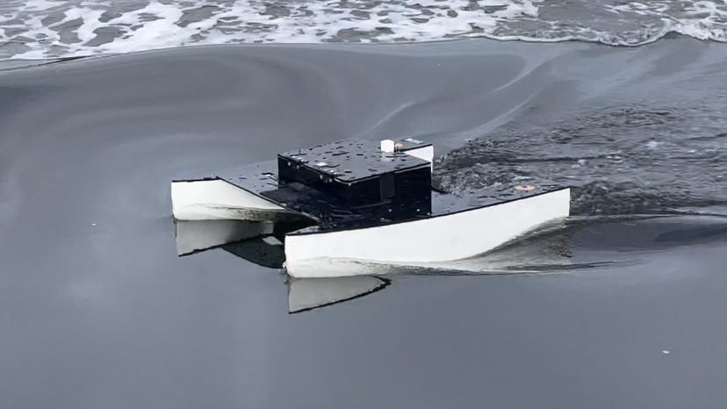
Autonomous Surface Vessel Spring 2022 1st Status Presentation
1/c Ryan Barlow, 1/c Patrick Raymond, 1/c Connor Glynn, 1/c Samuel Kim, 1/c Wilson Moorer, 1/c Chanbopich Tann
Advisors: LT Ledzian and Dr. Reza
17 February 2022
Notes:
Connor

Slide 2

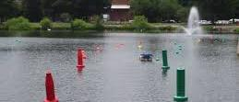

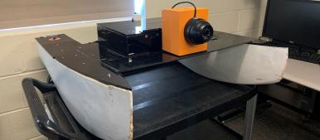
From Last Presentation
Consolidated documentation
Refined requirements
Improvements to current capabilities
Course of action and planned testing
Notes:
Connor

Slide 3
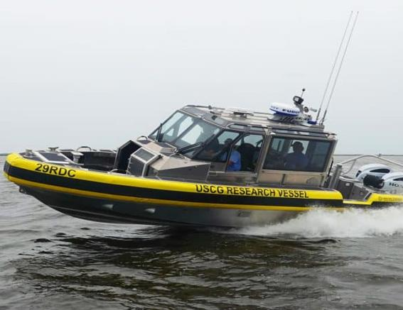
Refined Mission
Travel remotely and autonomously
Fulfill future capability gaps
Demonstrate technology to fulfill Coast Guard missions
Sense the environment and act accordingly
Notes:
-Ryan

Slide 4
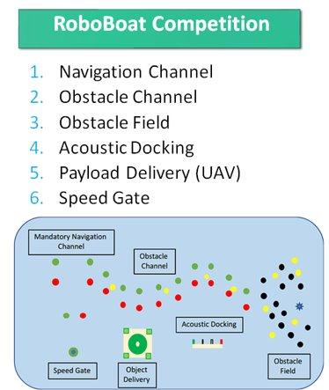
Competition Requirements
Autonomous driving capabilities
Emergency cutoff/takeover
UAV landing capabilities
Obstacle identification and avoidance
Notes:
Wilson

Slide 5
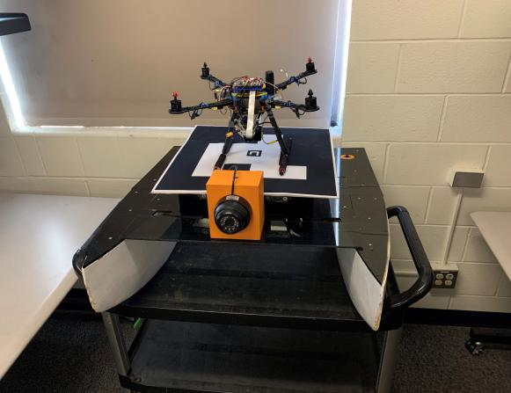
Updated Requirements
Travel both remotely and autonomously
Pathfinding algorithm solving for course
Communicate waypoints wirelessly
GPS waypoint tracking
Camera based channel navigation
Conduct UAV landing/takeoff
Notes:
Pat

Slide 6
GitHub
Easy storage of all documentation
Maintain and track changes to code
Provide “how to” documents
Pair code with working demonstrations
Prepare to hand off project to next class
Notes:
Tann

Slide 7
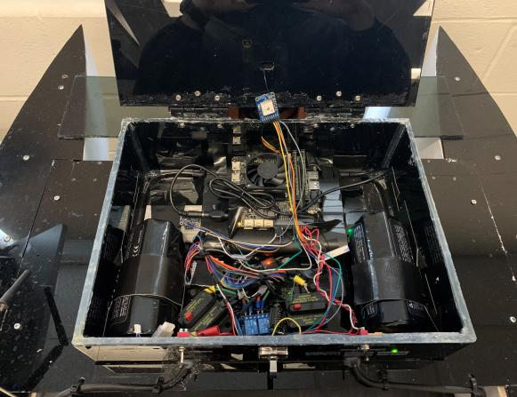
Current Progress and Tested Features
Manual remote handling
- Pool tested
Safety measures
- Bench tested
Hardware redesign
- Bench tested
PD Heading controller
- Pool tested
GPS waypoint tracking
- Thames River tested
Notes:
Tann

Slide 8
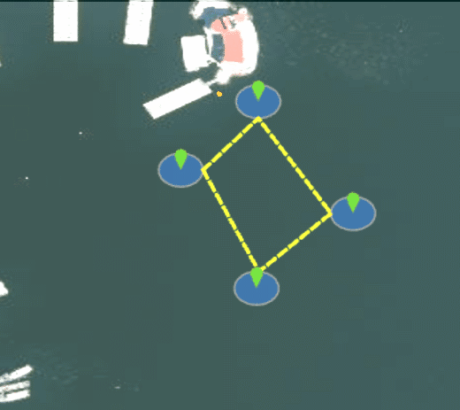
GPS Navigation
Notes:
Wilson
-don’t forget about state diagram from beginning of semester.
-Showing steps or transitions we had to go through
(stationary vs nonstationary motor control
Add multiple slides with the progression of the Thames River testing
Tell a story of how the vessel went from non-auto to auto

Slide 9
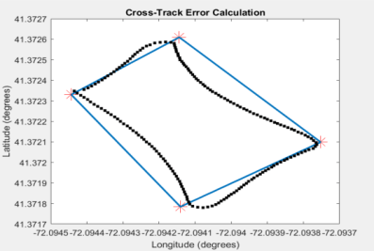

Performance Action Items
Goal: Decrease Cross-Track error to 10% of leg length
Solutions:
IMU Calibration/Start-up Routine
IMU Bias Elimination
Cross-Track Error Controller
Notes:
Connor

Slide 10
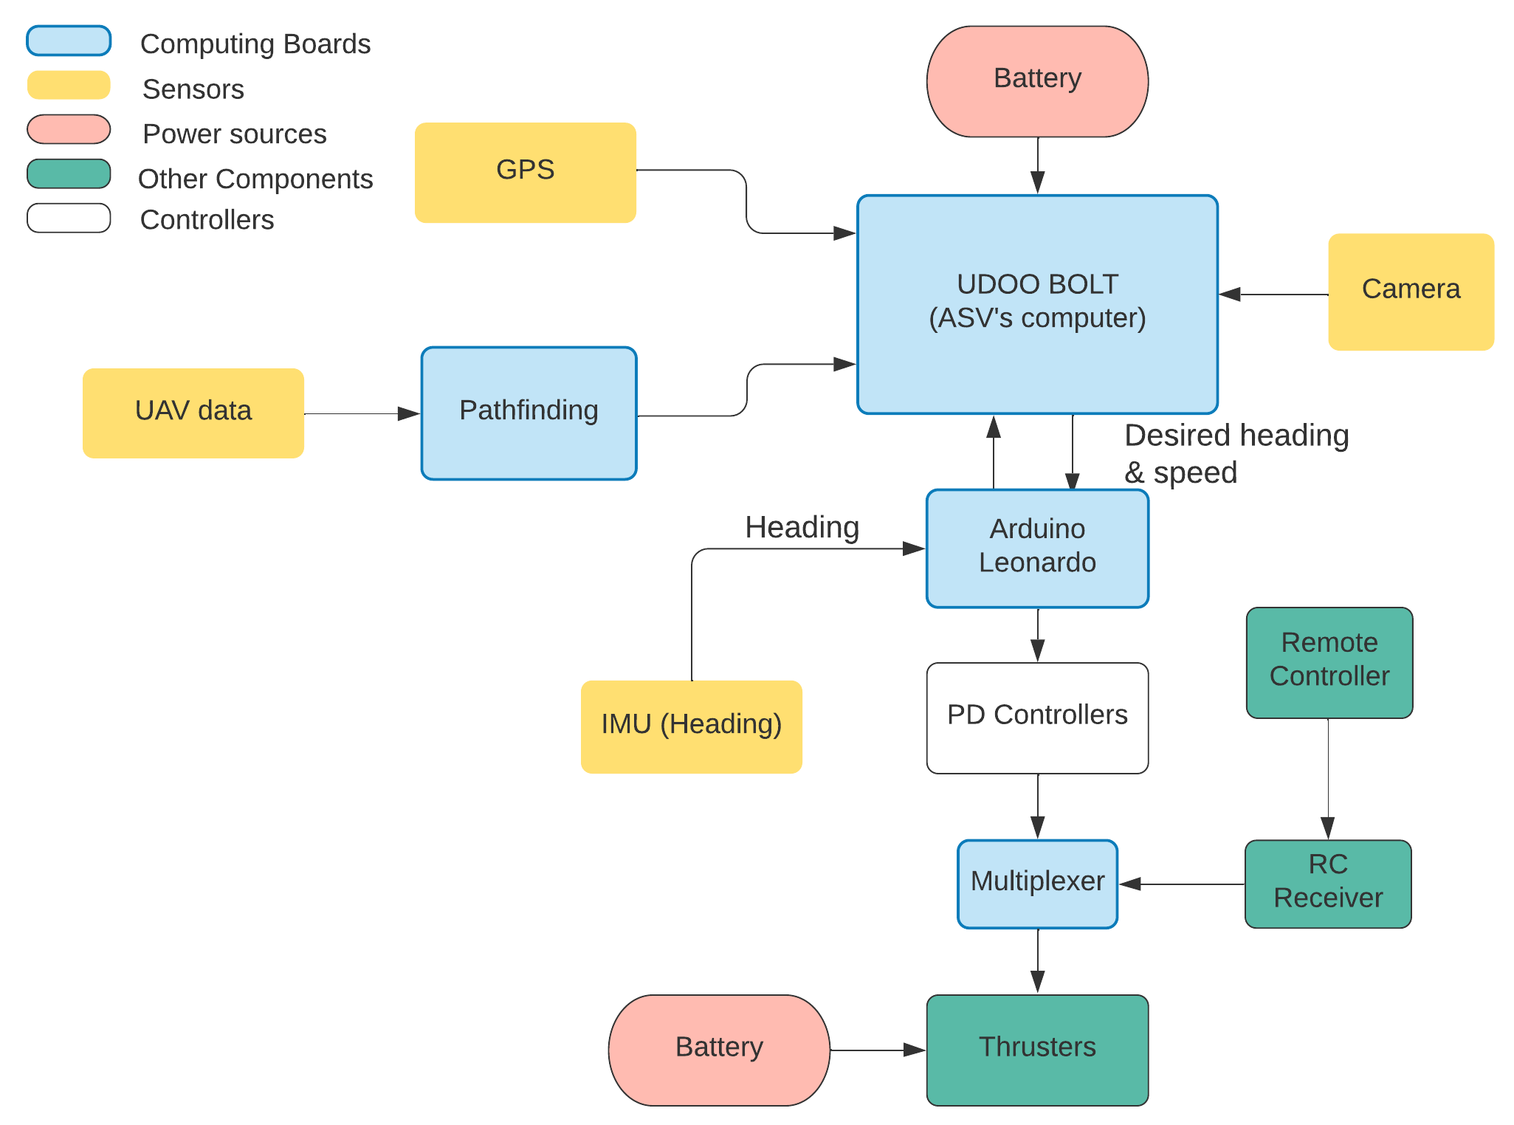
Finalized System Design
Notes:
Sam

Slide 11
Future Capabilities
IMU: Implementing calibration system to produce more accurate IMU data to reduce cross track error
01
Wireless Communication: transmit & receive GPS waypoints, competition commands
02
Image Processing: obstacle channel and speed gate navigation via onboard computer
03
UAV Landing Pad: design and construct to UAV team's requirements for landing using ArUco marker
04
Notes:
Tann

Slide 12
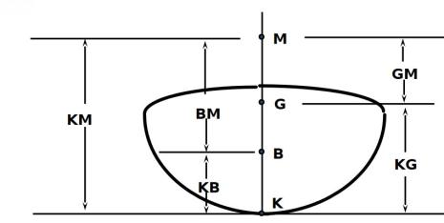









ASV Stability Calculations
- Center of Mass
- KM' = 9.7 inches (with landing pad)
- KG' = 8.78 inches (with landing pad)
KM' > KG' = Positive Buoyancy
Roll Period = 14.2 seconds – decrease of 0.5 seconds with addition of landing pad
Maximum Righting Angle = 48.5 degrees
(Center of Gravity)
Notes:
Ryan
KG = 8.1 inches (without landing pad)
KM = 9.02 inches (without landing pad) Positive Buoyancy – will return to upright state if displaced
Only a change in roll period of approx 3-4%

Slide 13
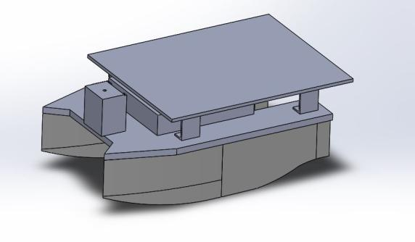
Updated Model View of ASV
Notes:
Ryan

Slide 14
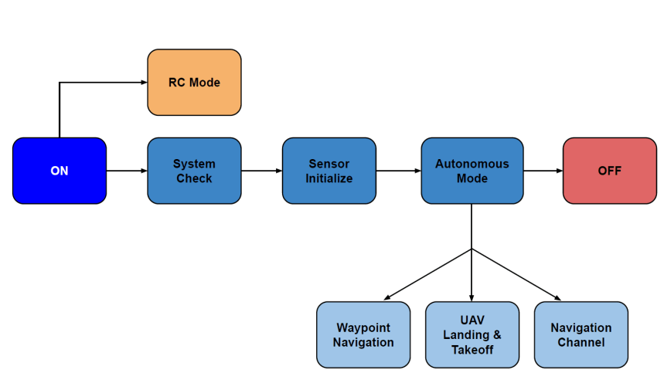
State Block Diagram
Notes:
Sam

Slide 15
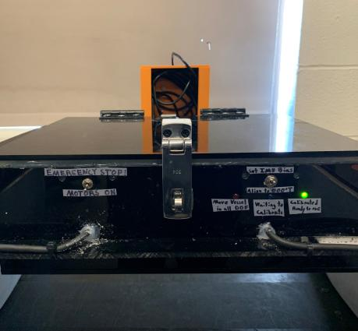
System Start-up State Demo
Notes:
Pat

Slide 16
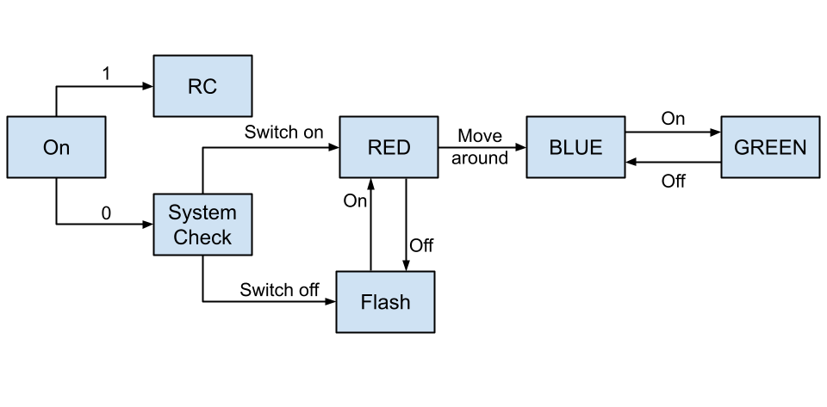
System Start-up States Demo
Notes:
Pat

Slide 17
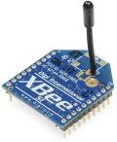
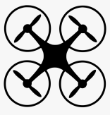

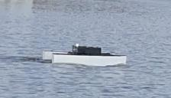
Wireless Communications
XBee Modules
Connect ASV, UAV, and any off-vessel computer wirelessly
Initial Implementation: Send GPS coordinates from remote computer
Final Implementation: Send ASV update messages and communicate within UAV mesh network
Notes:
Connor

Slide 18
Future Testing Progression
Transmit GPS coordinates from computer
- Bench Test
Outdoor channel navigation
- Thames River
UAV landing/takeoff
-TBD
Week 6
Week 10
Week 11
Week 13
Week 9
Week 11
Week 12
IMU calibration
-Bench Test
Indoor channel navigation
- Roland Pool
Waypoint navigation w/ improved IMU
- Thames River
Full system integration
- Thames River
Notes:
Pat

Slide 19
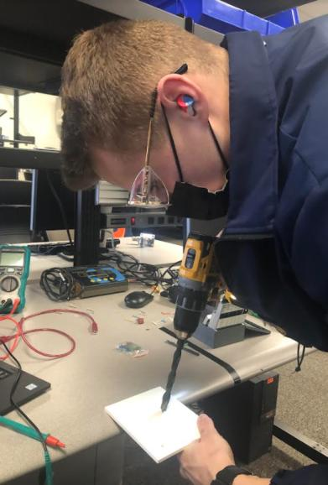
Testing Safety and Risks
Loss of controllability
Damage to electronics
Water entering electrical box
Unrepairable damage to vessel
Notes:
Pat
Damage to vessel is biggest threat

Slide 20
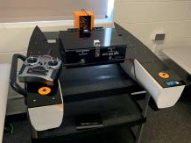
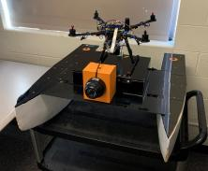
Future Goals
Short Term Goals
Channel navigation
AI path finding
Xbee communications
Camera navigation
Long Term Goals
UAV communications
Speed controller
Obstacle avoidance
UAV takeoff & landing
Notes:
Sam

Slide 21
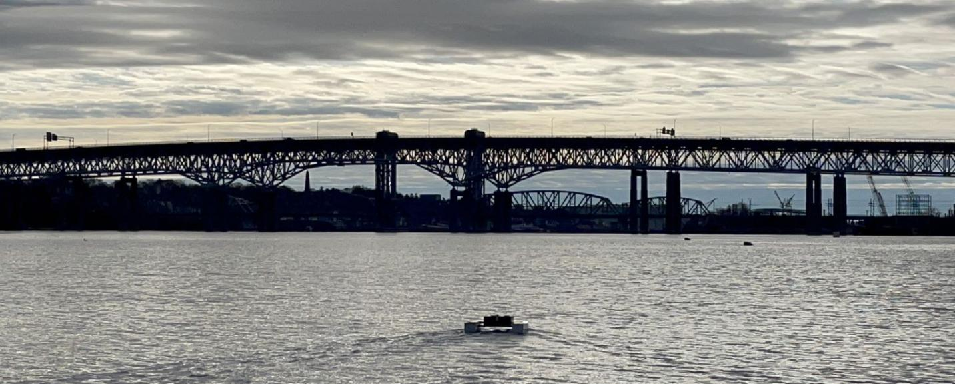
Questions?
Questions?
Notes:
-Connor

